Slide 1
Module 04
MMC Converter

Slide 2
Modular Multilevel Converter (MMC)
Energy storage elements are distributed Submodules (SM)
No series connection of IGBTs → IGBTs are not switched at the same time
Reduced switching impulses

Slide 3
Modular Multilevel Converter (MMC)
Voltage creation by switching on and off the capacitors
Assuming the voltage steps are small enough, any voltage shape can be created
With the 3.3 kV IGBT, a capacitor voltage of ~ 2kV can be assumed

Slide 4
Controllable Voltage Source
Voltage converter consists of six controllable voltage sources
Voltage sources can be controlled independently

Slide 5
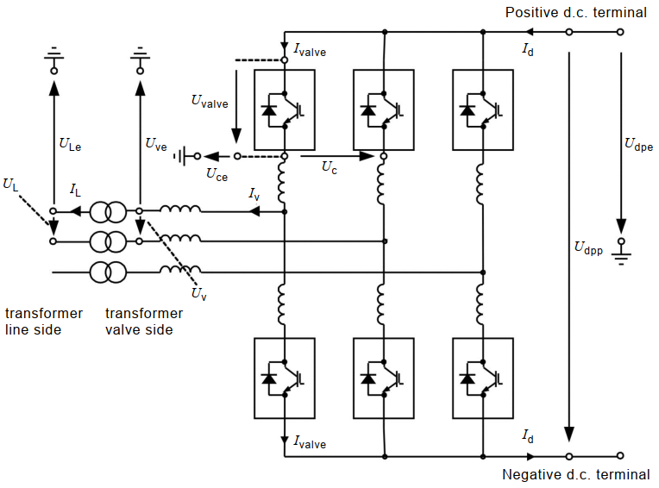
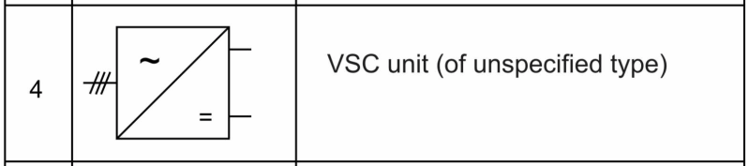
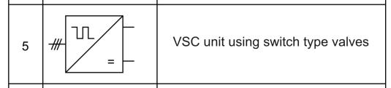
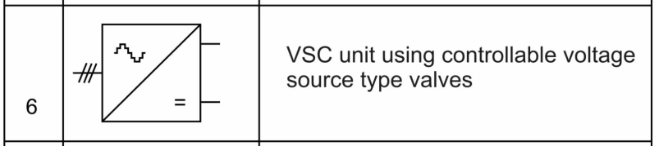
Converter Terminology IEC 62747:2014
2- and 3-Level converter
MMC converter

Slide 6
MMC – Voltage Creation
+ 4kV
- 4kV
Assumption: U_{cap} = 2kV
U_{valve_p} = 6 kV
U_{valve_n} = 2 kV
U_{dpp} = 8 kV
U_{ve} = -2 kV
U_{valve_p} = 4 kV
U_{valve_n} = 4 kV
U_{dpp} = 8 kV
U_{ve} = 0 kV
U_{valve_p} = 2 kV
U_{valve_n} = 6 kV
U_{dpp} = 8 kV
U_{ve} = +2 kV

Slide 7
Controllable Voltage Source

Slide 8
Controllable Voltage Source

Slide 9
Controllable Voltage Source

Slide 10
Controllable Voltage Source

Slide 11
Modulation Index

Slide 12
Modularization
Higher DC voltage can be reached by connecting additional SMs in series or by using SMs with higher voltage capability → Other IGBT types
For higher currents other IGBTs must be used → Other SMs

Slide 13
Submodule set-up
Submodule
Submodule is a device which is capable to switch on or off the individual capacitor voltage at its terminal
Additional elements are:
Thyristor
Bypass Switch

Slide 14
Operating conditions
Operating Conditions of Half Bridge Submodule

Slide 15
Redundancy concept
Submodule redundancy is achieved by mechanical bypass switch
In case of a submodule fault the bypass switch is closed creating a low resistance short circuit of the SM
Mechanical bypass switch

Slide 16
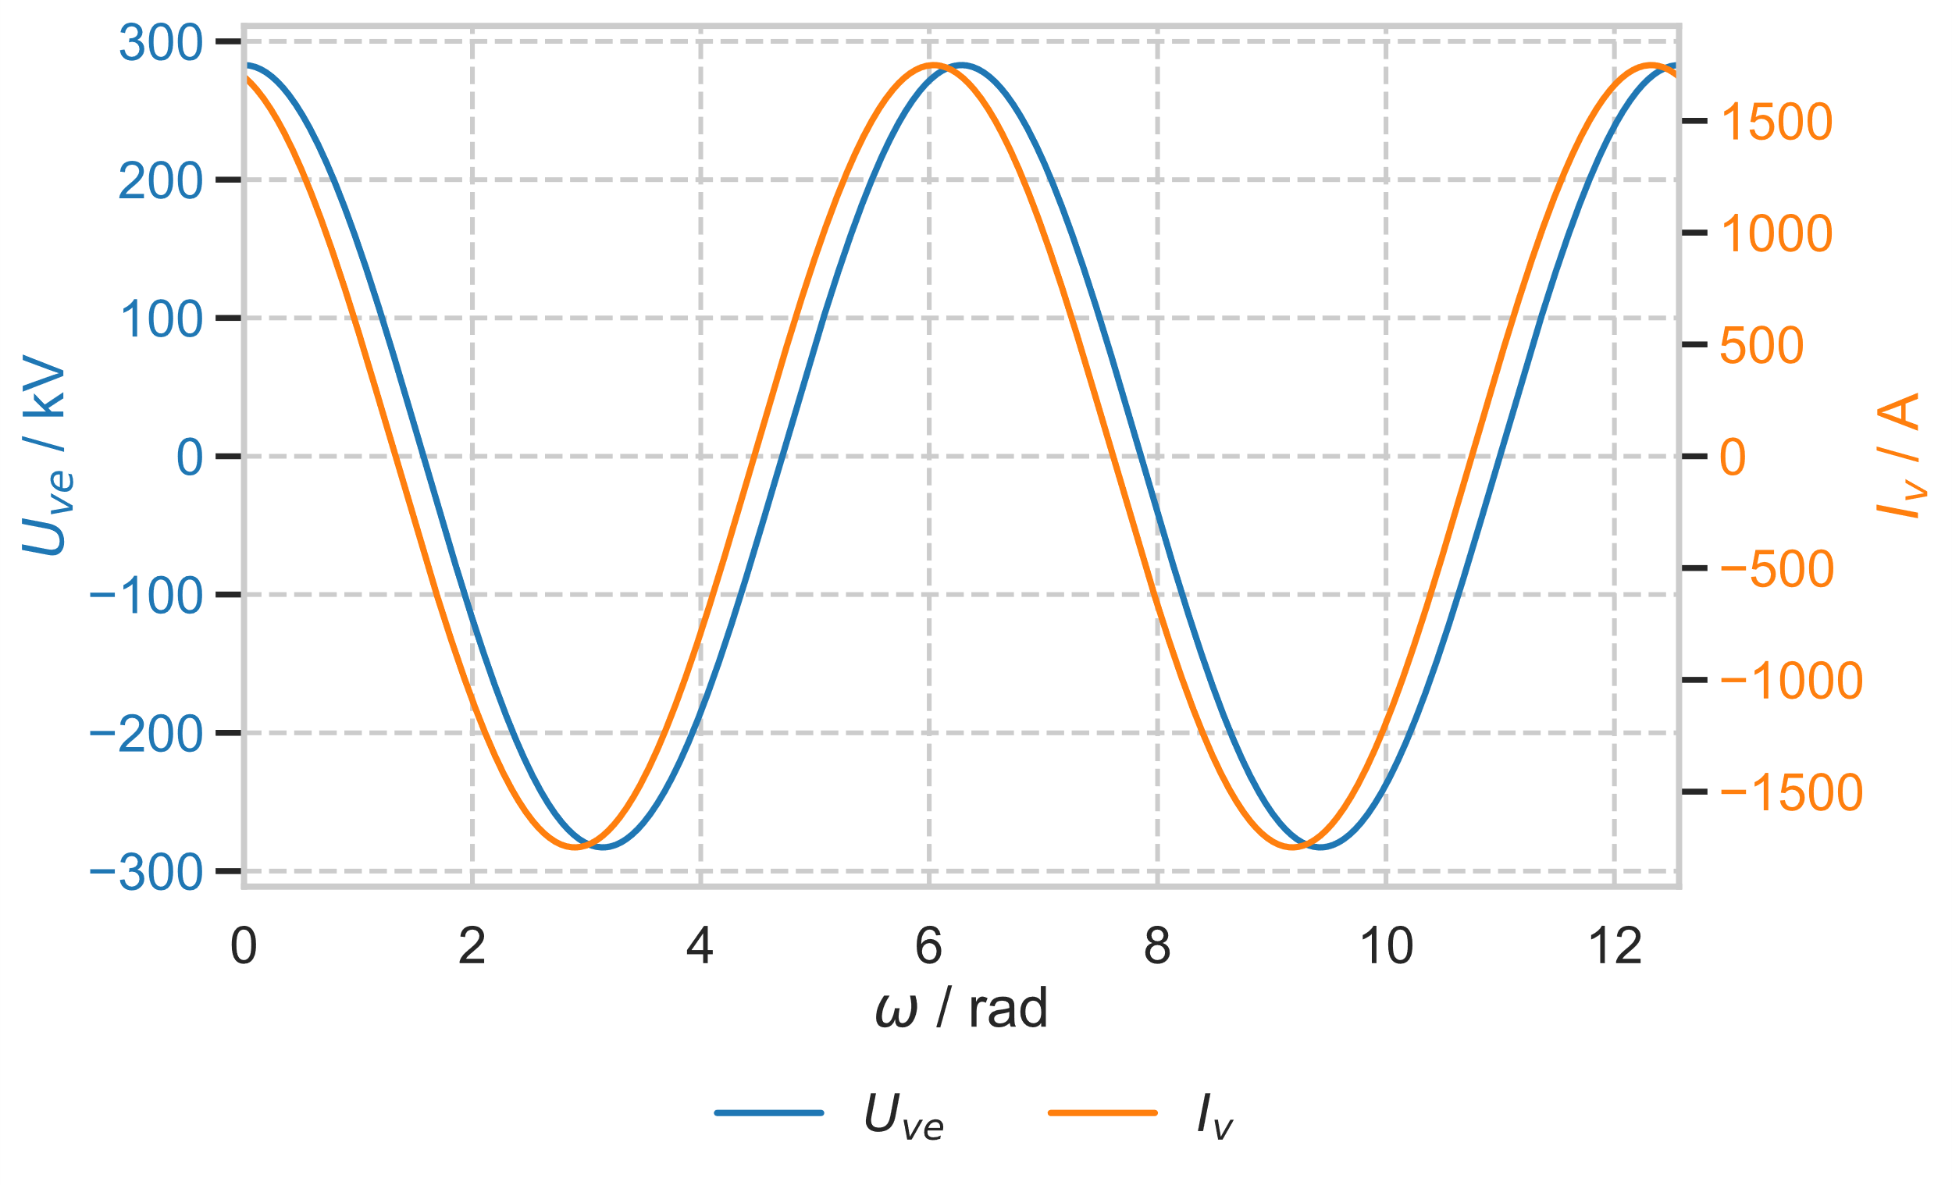
AC side voltage

Slide 17
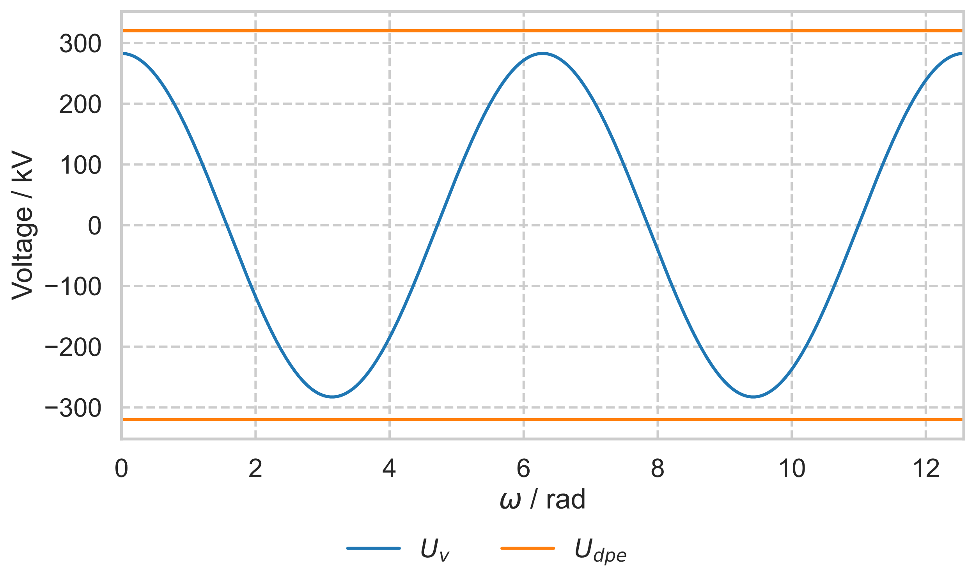
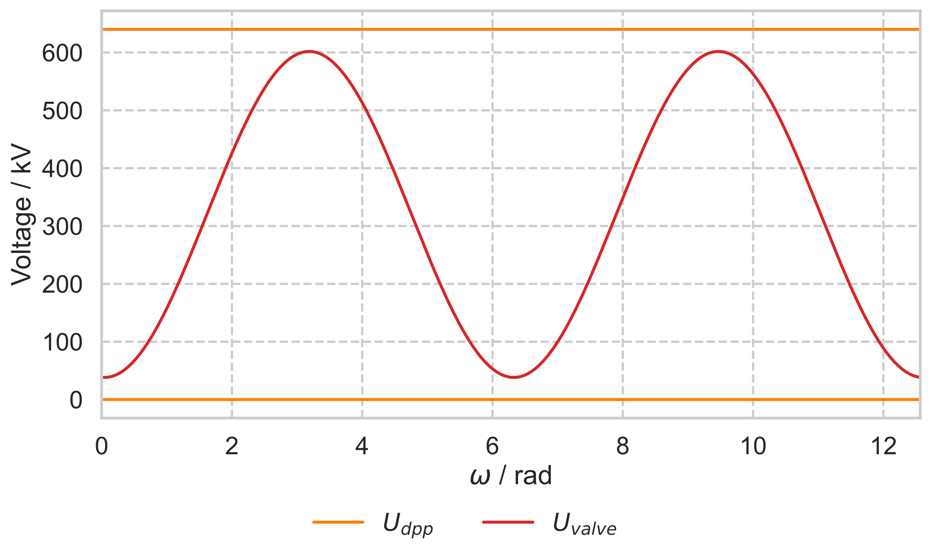
Module Voltage

Slide 18
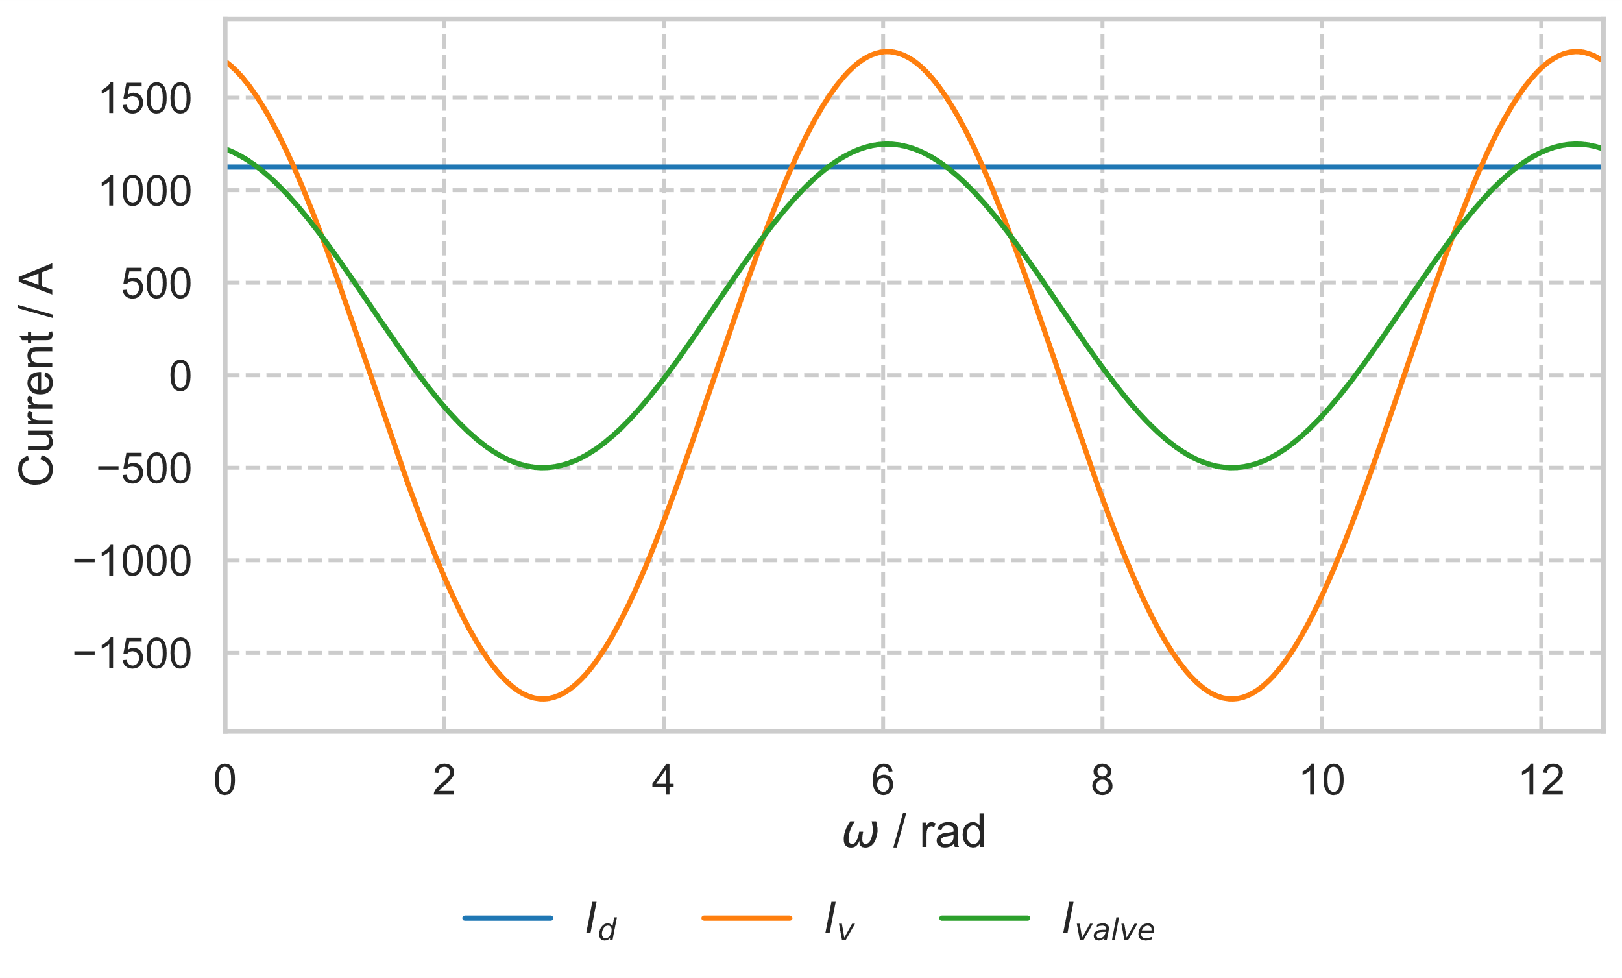
Module Current

Slide 19
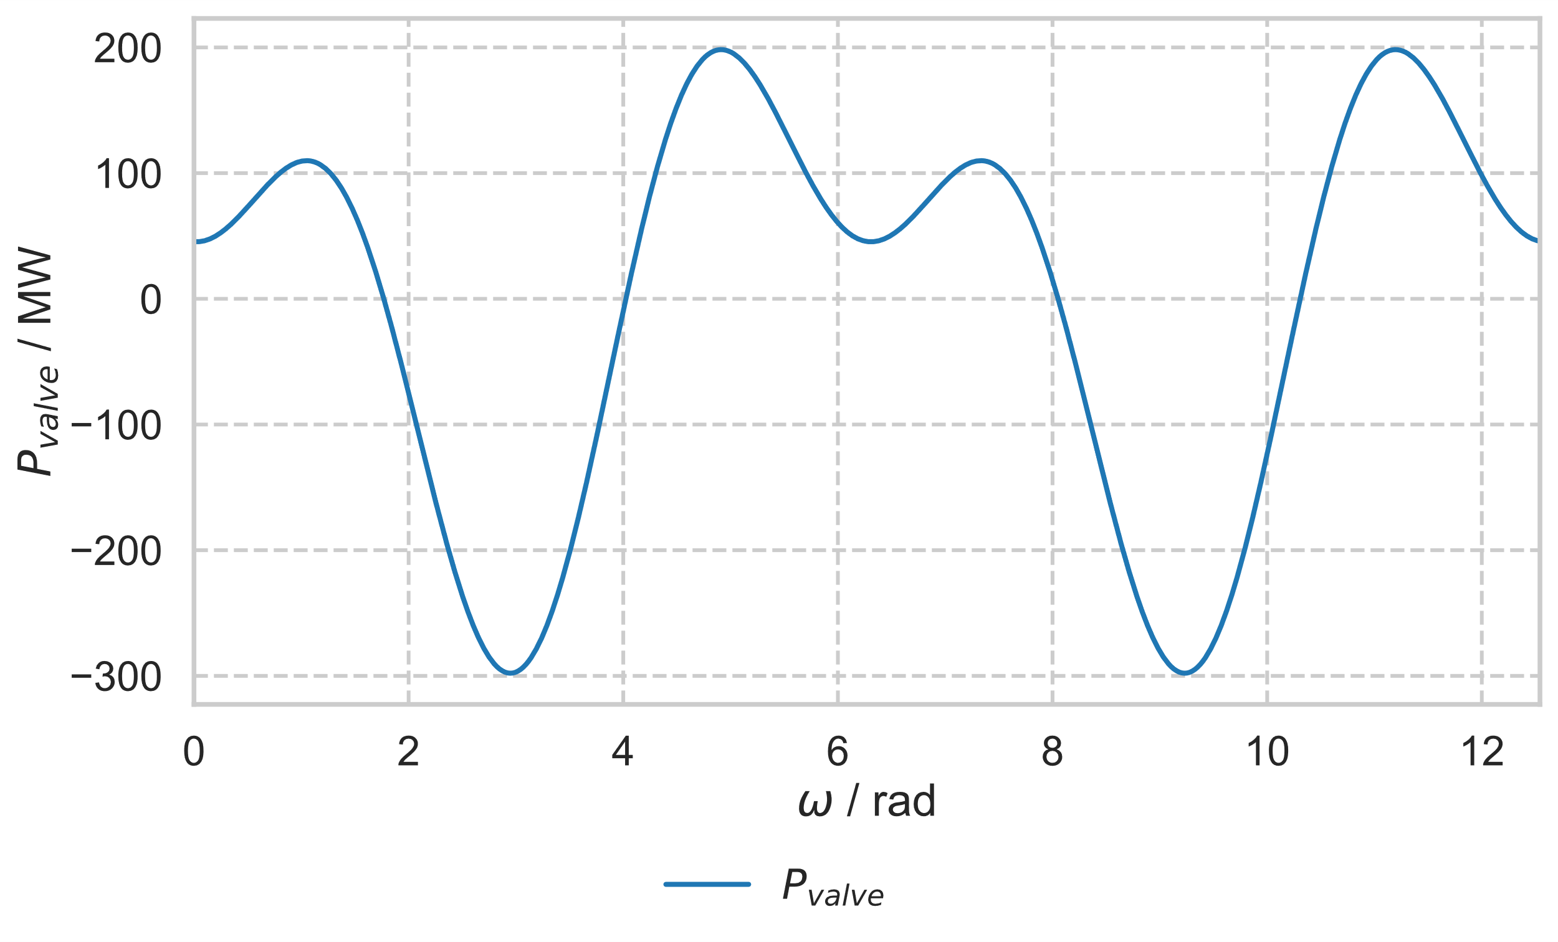
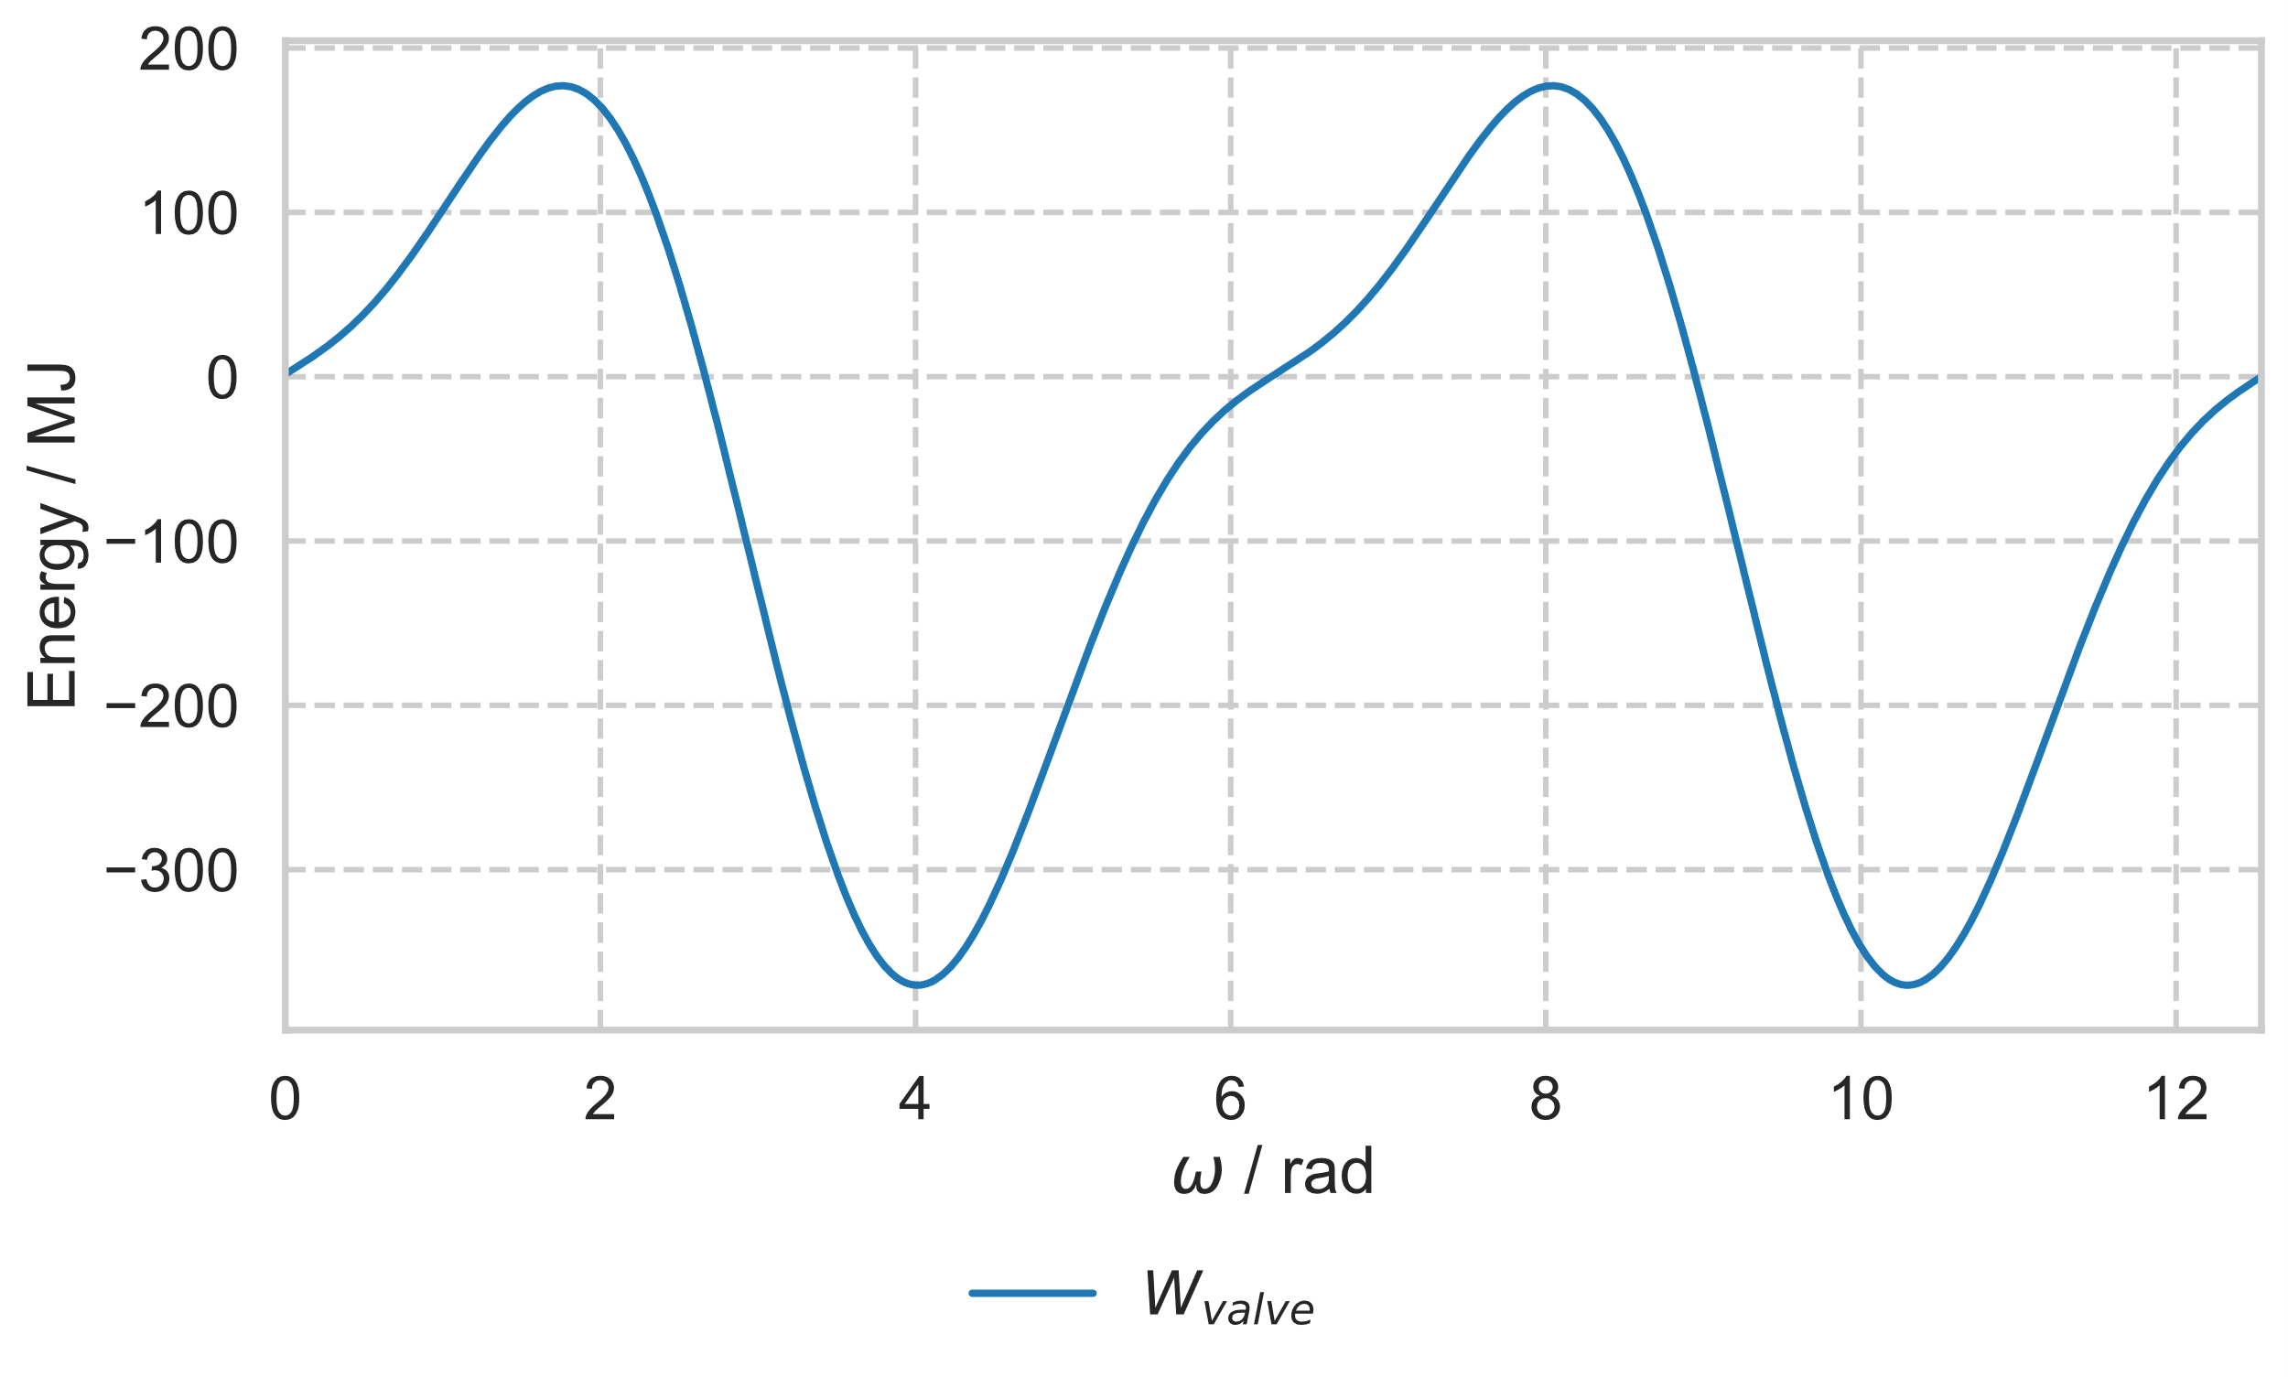
Module Power and Energy

Slide 20
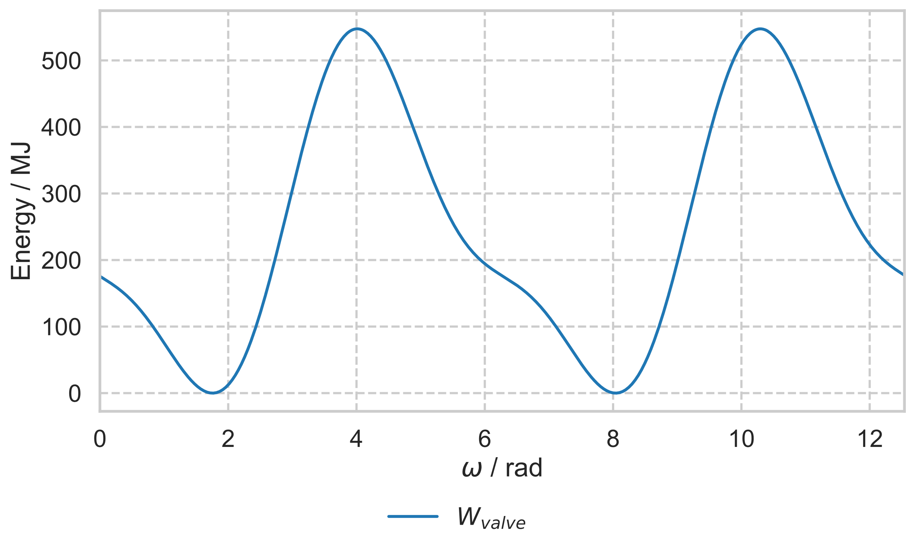
Module Energy
SM has negative voltage, which is physically not possible
SM is discharged to zero

Slide 21
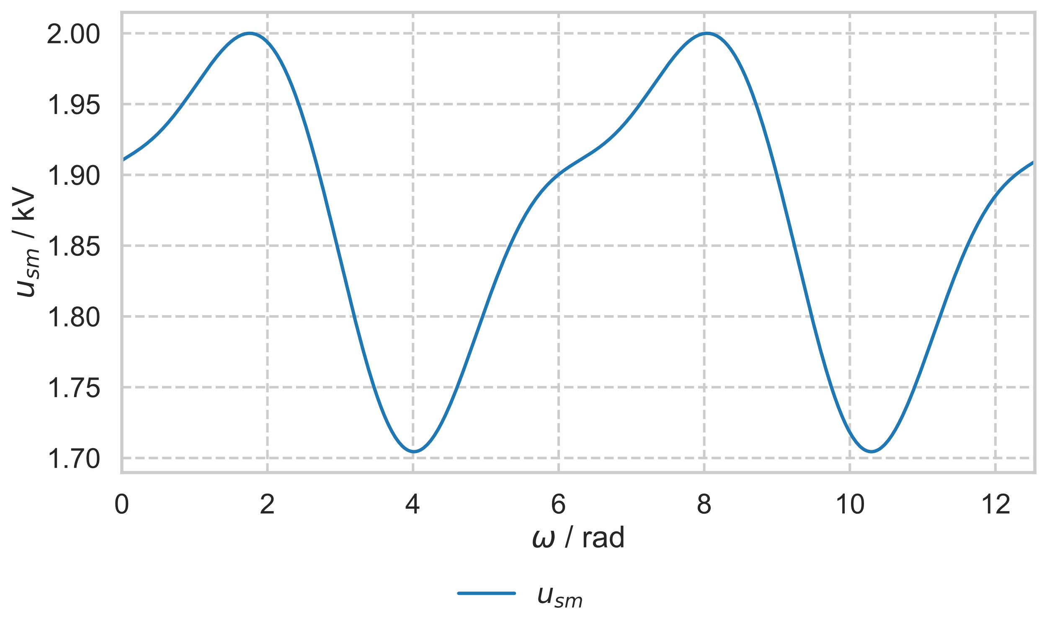
SM voltage
Parameter | Value
C_{SM} | 5 mF
U_{sm_max} | 2000 V
N_{SM} | 200, 400
N_{SM} = 200

Slide 22
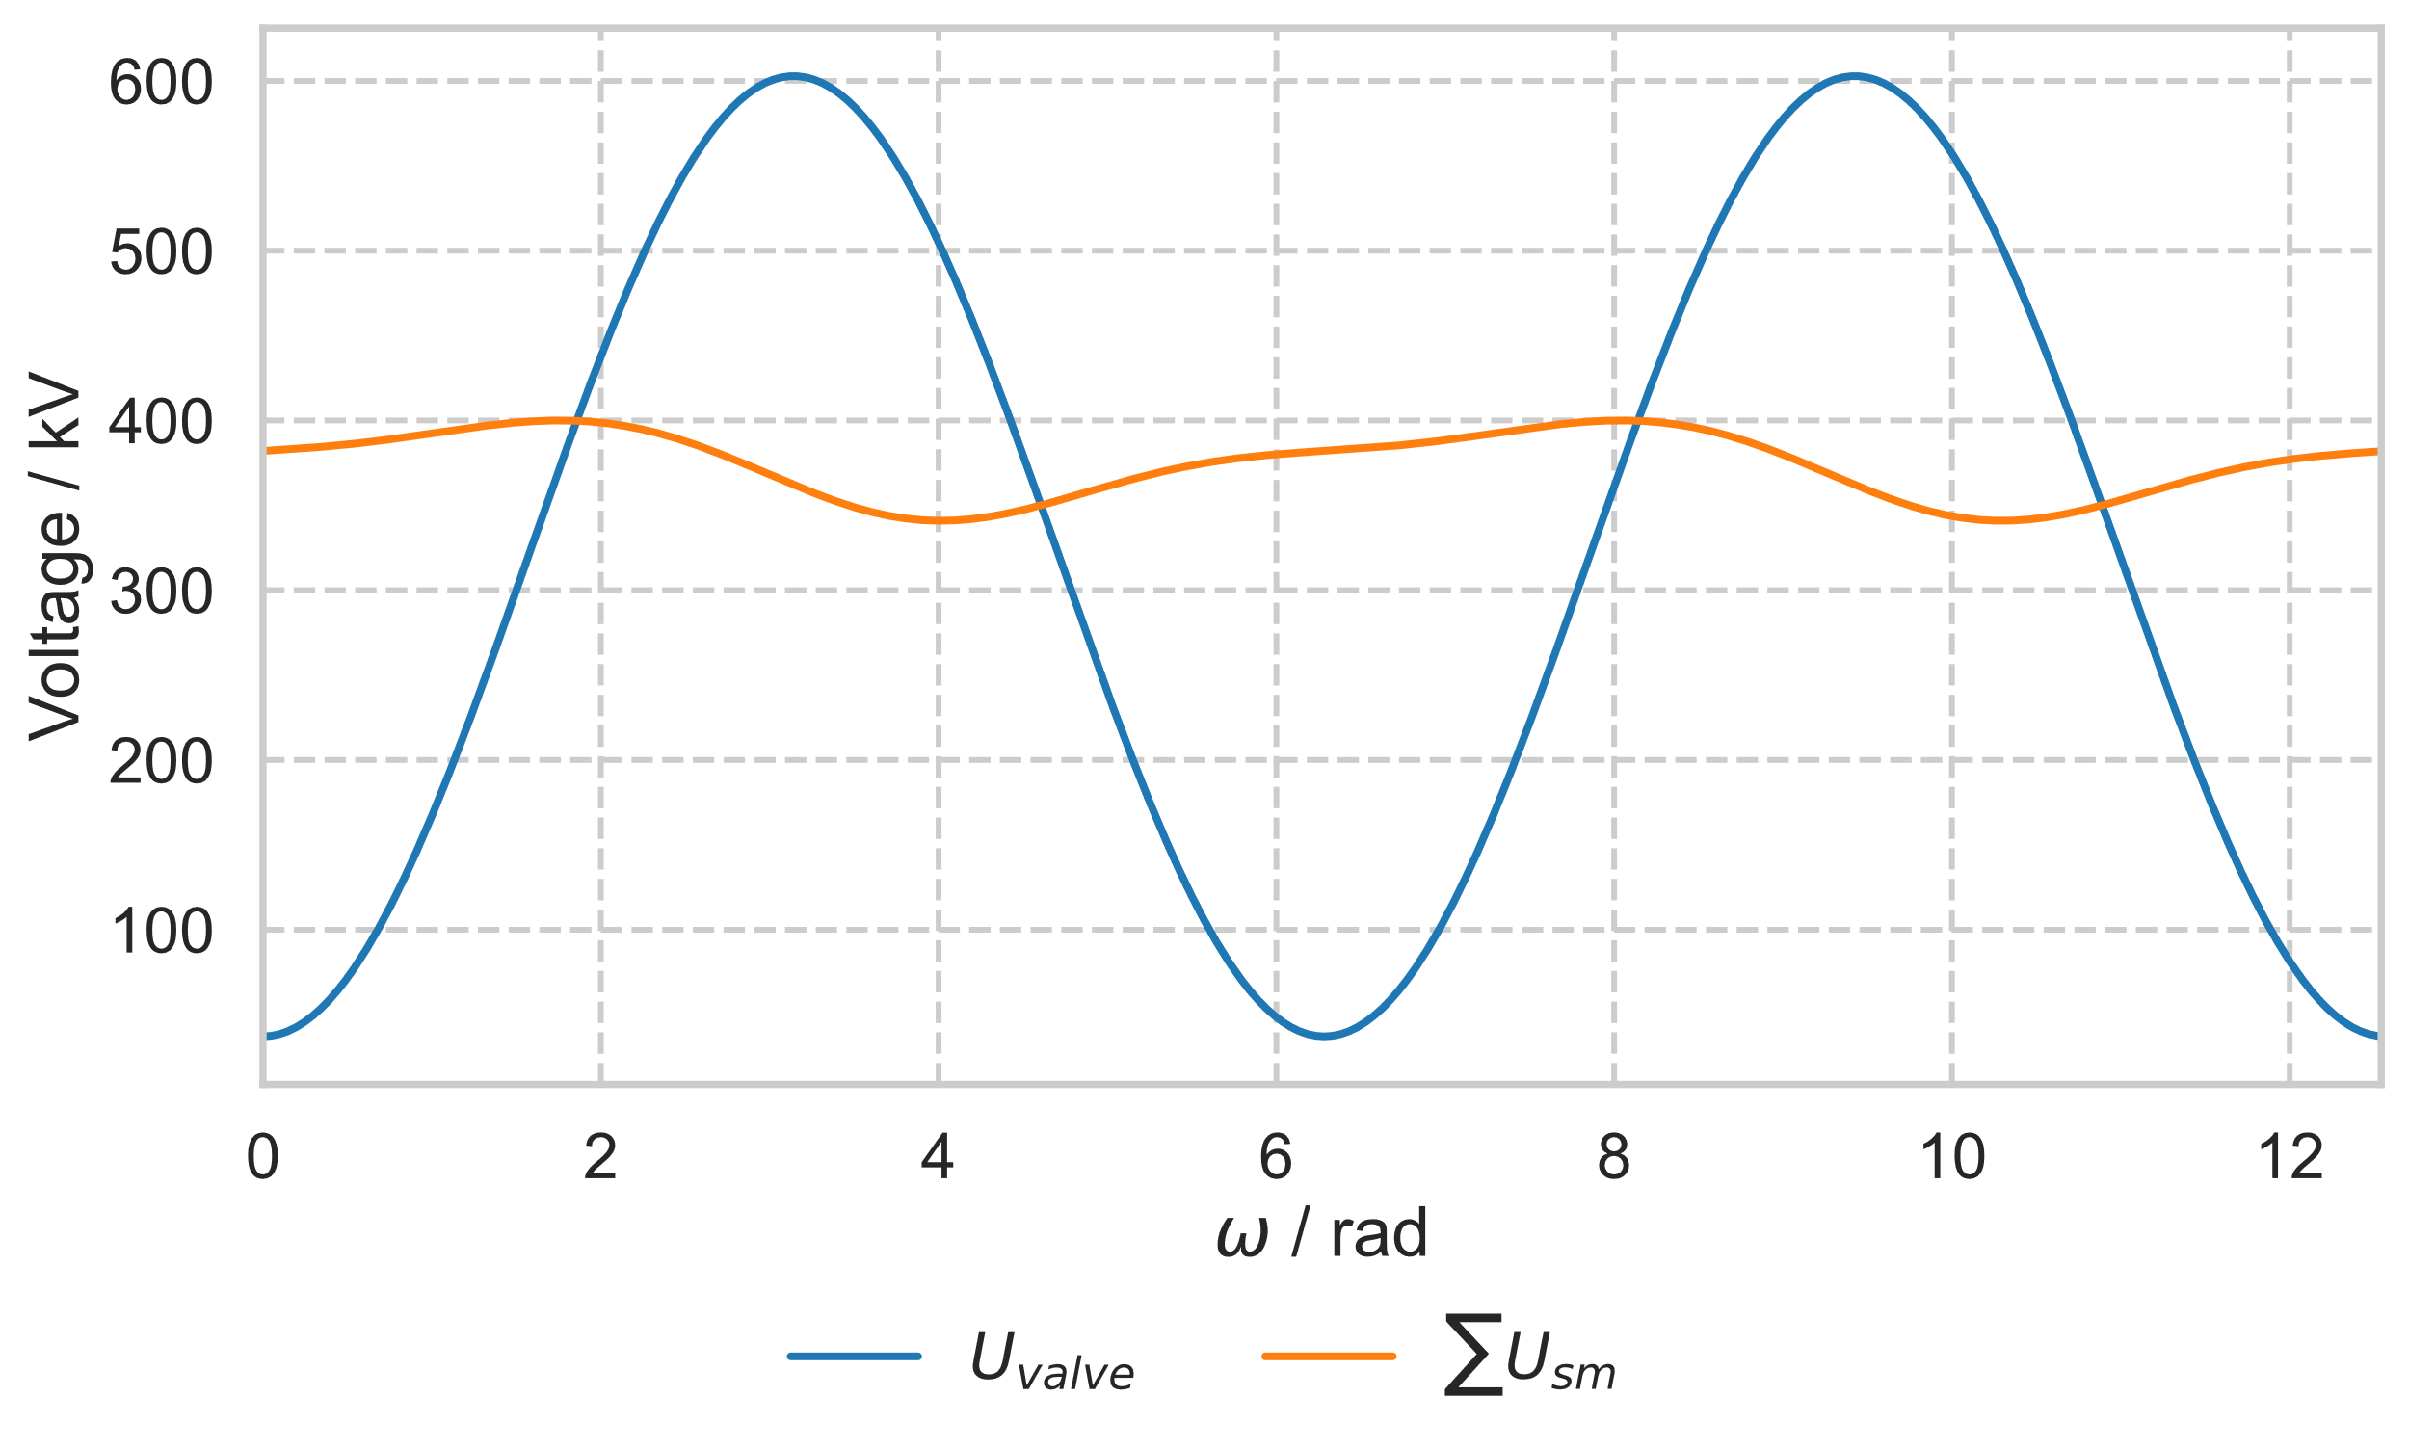
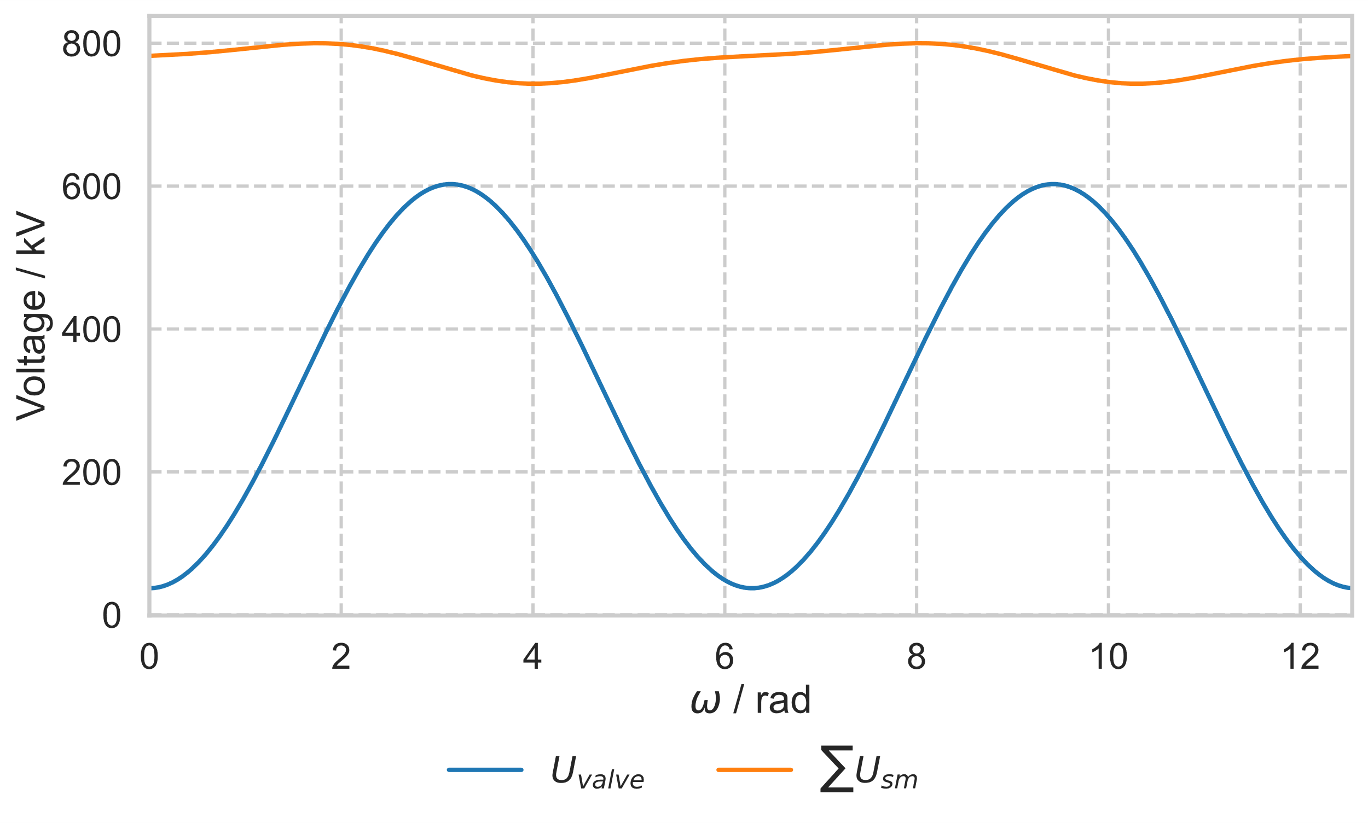
SM and valve voltage
N_{SM} = 200
N_{SM} = 400

Slide 23
SM and valve voltage
N_{SM} = 200
N_{SM} = 400

Slide 24
SM to valve voltage
SM are used not just to store energy for power transmission but also for module voltage generation
At any point the sum of the SM voltage must be higher than the requested module voltage
The relation between sum of SM and the required module voltage is called inner modulation index a
a

Slide 25
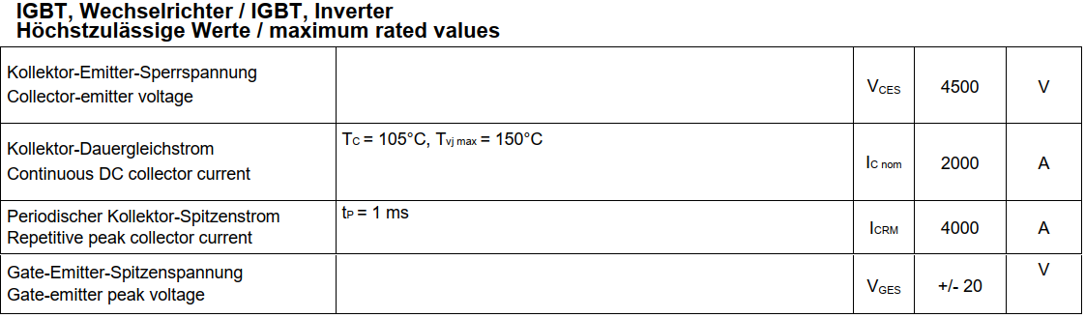
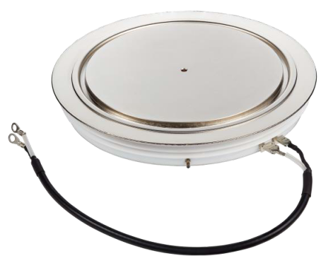
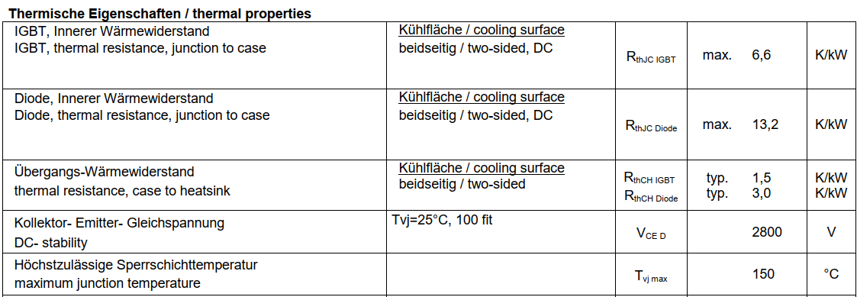
Relevant data from IGBT data sheet
P2000DL45X168

Slide 26
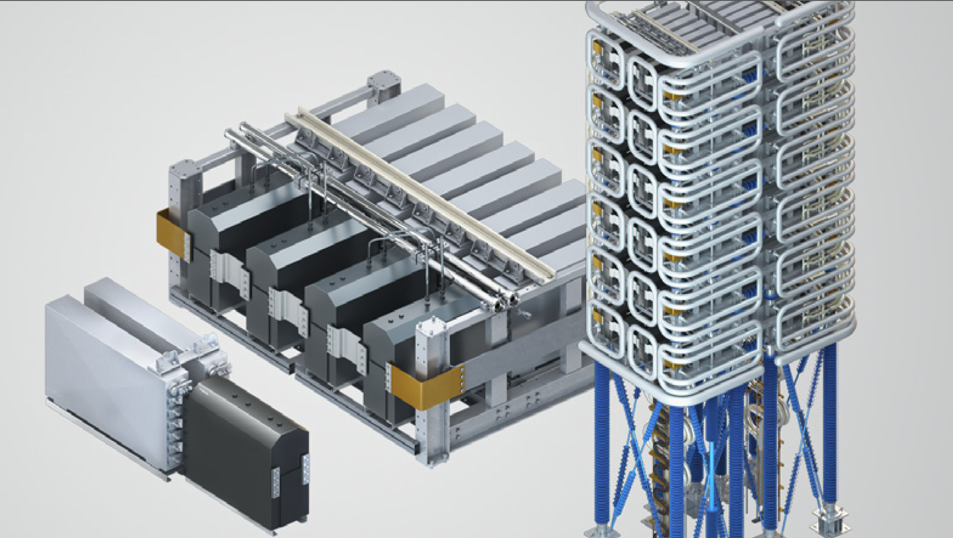
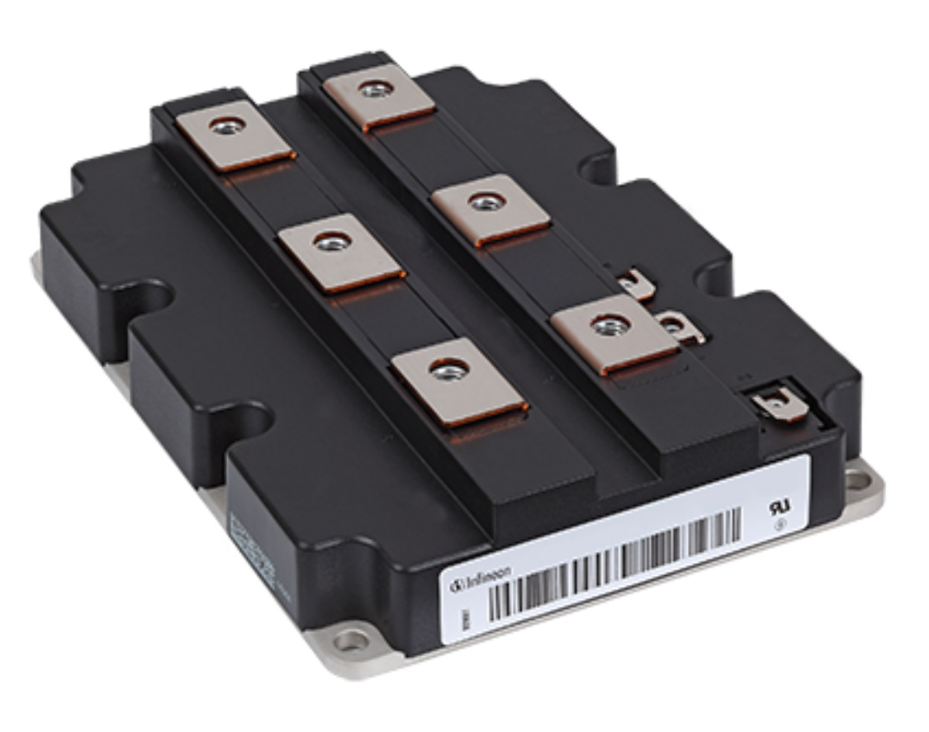
infineon.com
HVDC VALVES Power Electronics for HVDC Schemes
2019, General Electric Company

Slide 27
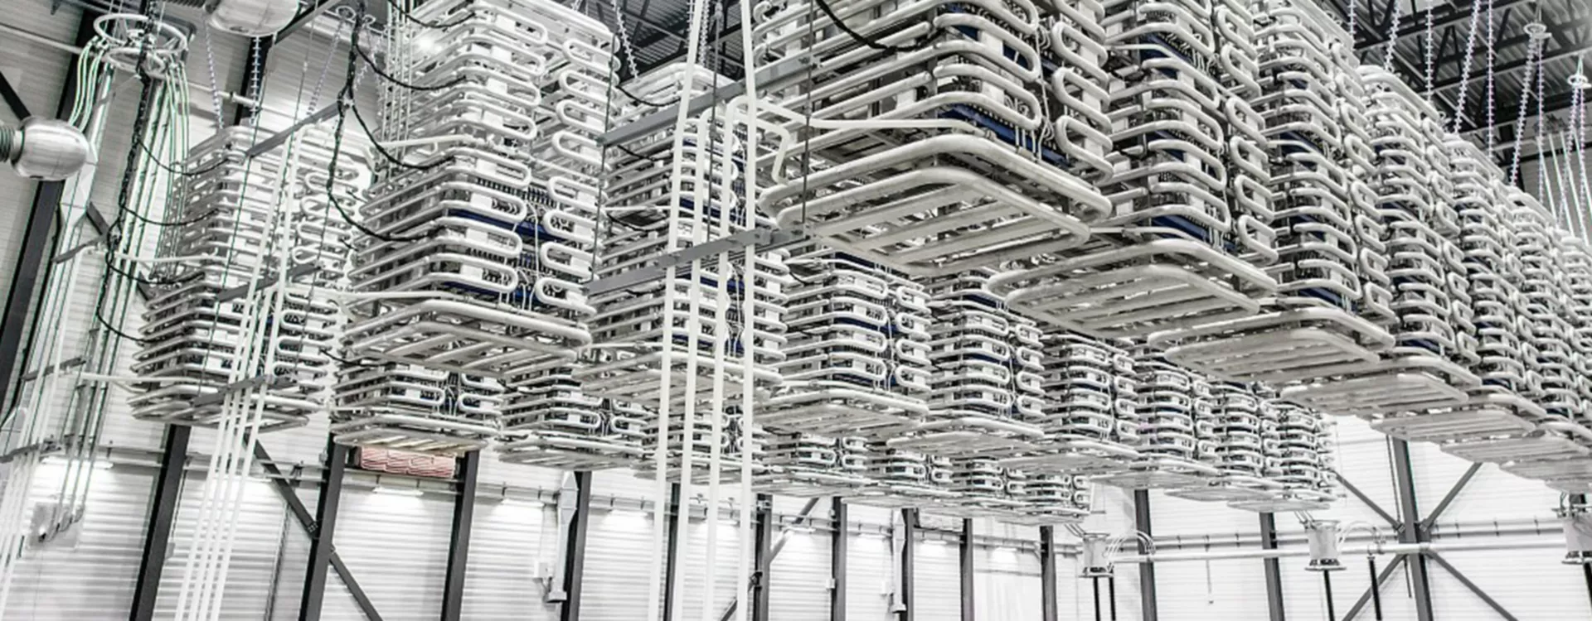
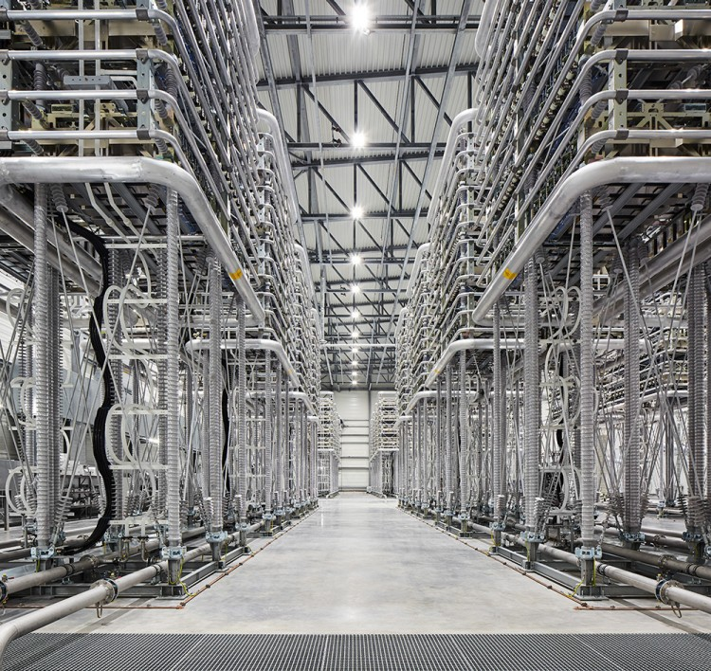
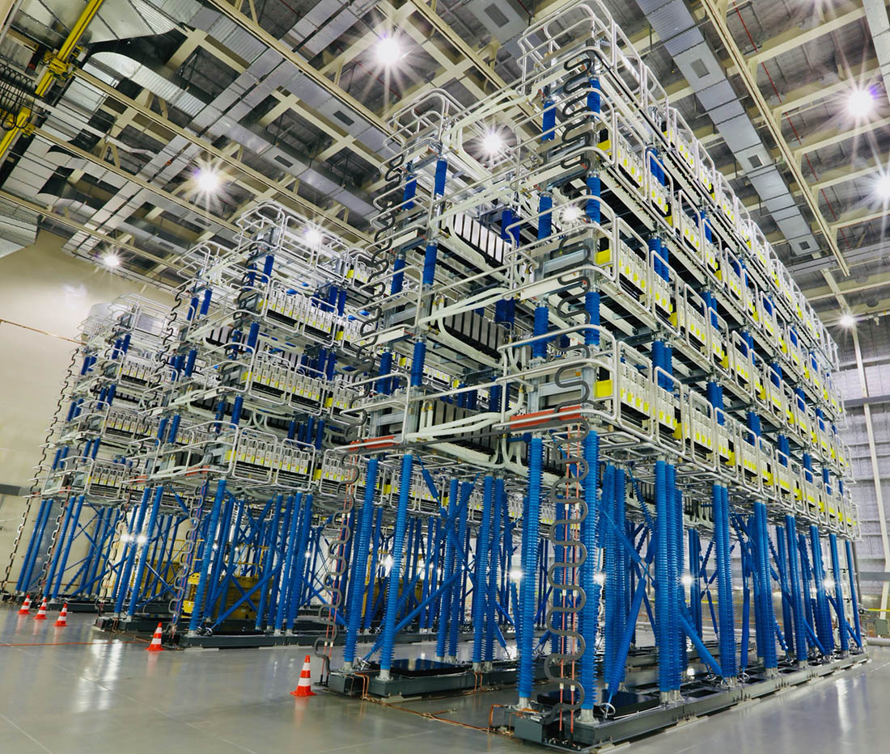
https://www.hitachienergy.com/ca/fr/news/press-releases/2021/12/hitachi-energy-wins-major-contract-for-the-first-of-its-kind-sub-sea-power-transmission-network-in-the-mena-region-advancing-a-sustainable-energy-future-for-abu-dhabi
https://www.ge.com/news/taxonomy/term/6426

